Slide 1
Diversity & Inclusion
November 21, 2020
Michelle Cali
Unit Serving Executive, Cub Scout Serving Area 6
Malena Hyde
Exploring Associate

Slide 2
Objectives
Understand Diversity, Inclusion, and Unconscious Bias
Learn techniques to overcome unconscious bias
Understand how these concepts apply to Scouting

Slide 3
Notes:
When we focus on one thing, we miss everything around it!
Did you notice:
The motor scooter changed to two bikes
Pink house now has a striped awning
The pink house changed from pink and red to beige and red
The green house changed to a blue house
Woman walking down the street
The name on the green building changed
The black smaller car changed to a van
The brick and green house has multi-colored streaming on it
The brick and green house went from no address on there, to an address on there
The brick and green house changed to a light green and dark green house with a balcony
There’s a ladder leaning up against the light green and dark green house
The lady holding a pig

Slide 4
Definitions
Diversity is the range of human differences, including but not limited to race, ethnicity, gender, gender identity, sexual orientation, age, social class, physical ability or attributes, religious or ethical values system, national origin, and political beliefs.
Inclusion involves bringing together and harnessing diverse forces and resources in a way that is beneficial. Inclusion puts the concept and practice of diversity into action by creating an environment of involvement, respect, and connection—where the richness of ideas, backgrounds, and perspectives are harnessed to create business value and overall success.
Source: http://www.diversityjournal.com/1471-moving-from-diversity-to-inclusion/
Notes:
These characteristics could be everything that makes us unique, such as our cognitive skills and personality traits, along with the things that shape our identity (e.g. race, age, gender, religion, sexual orientation, cultural background).

Slide 5
Diversity is a fact.
Inclusion is a behavior.
Notes:
Diversity does not equal inclusion.
Inclusion is Diversity + Engagement.
Diversity is having a seat at the table…existing in a space; whereas inclusion is having a voice AND being heard.

Slide 6
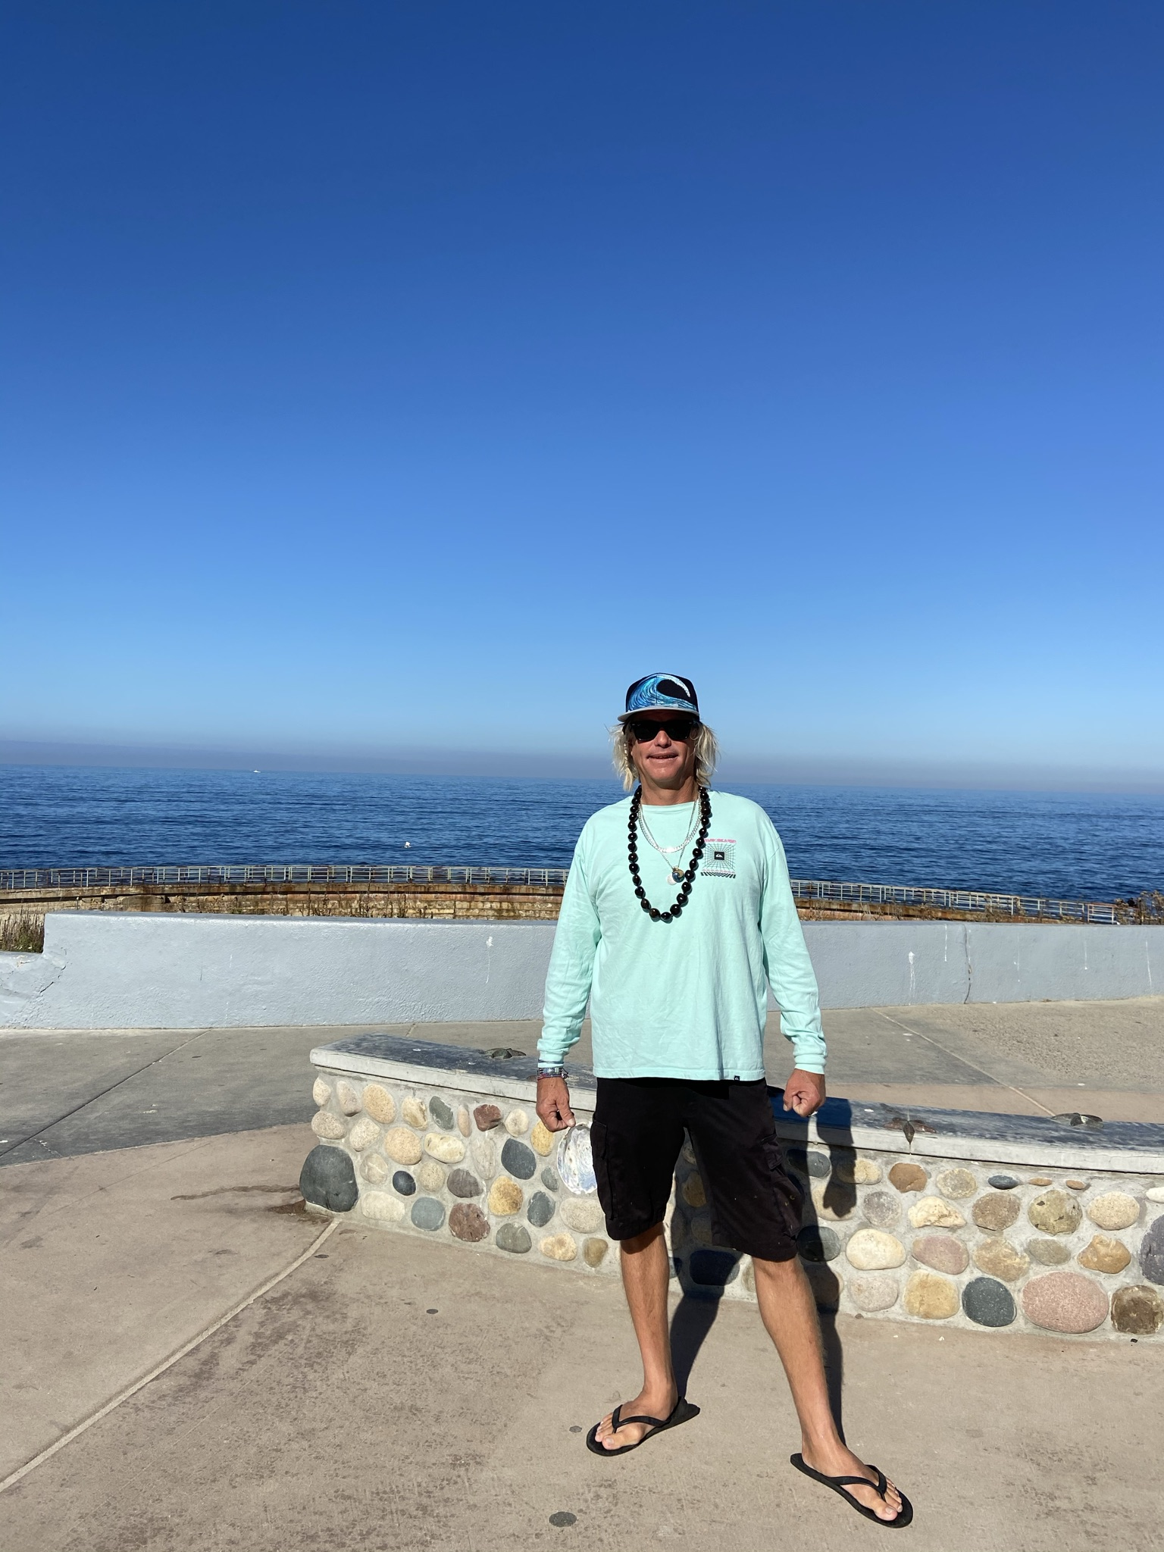
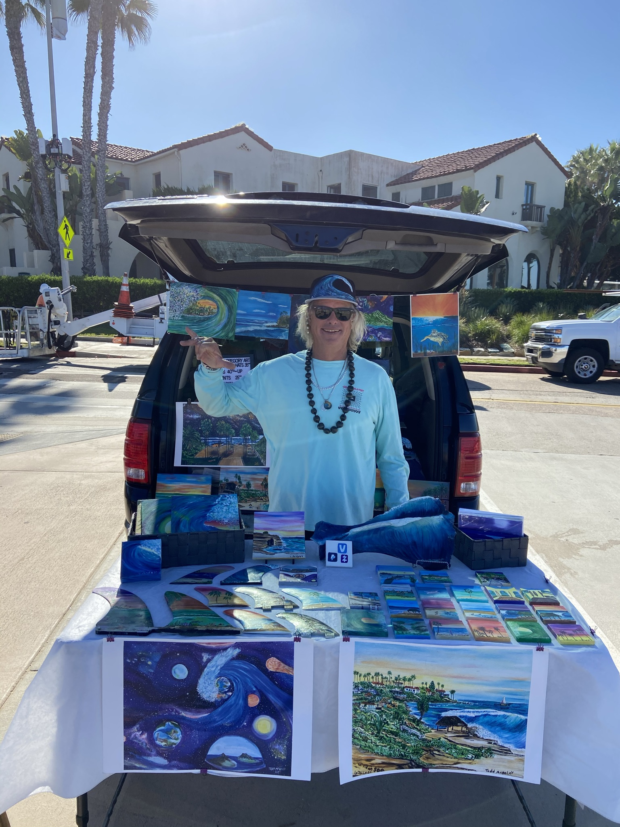
UNCONSCIOUS BIAS

Slide 7
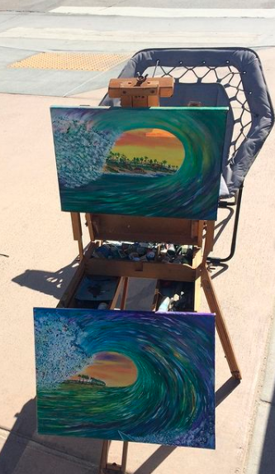
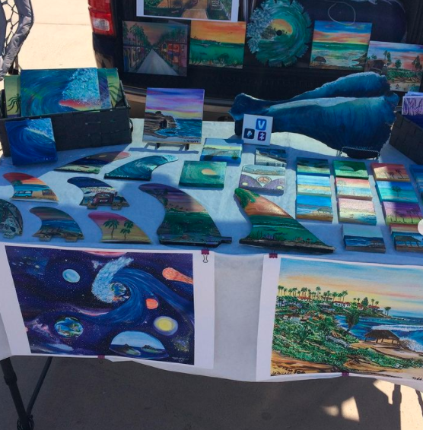
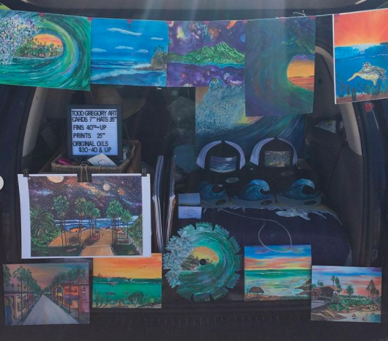
Todd McNeley
https://toddgregorysurfart.wixsite.com/website
todd_gregory_surf_art
toddgregorysurfart@gmail.com

Slide 8
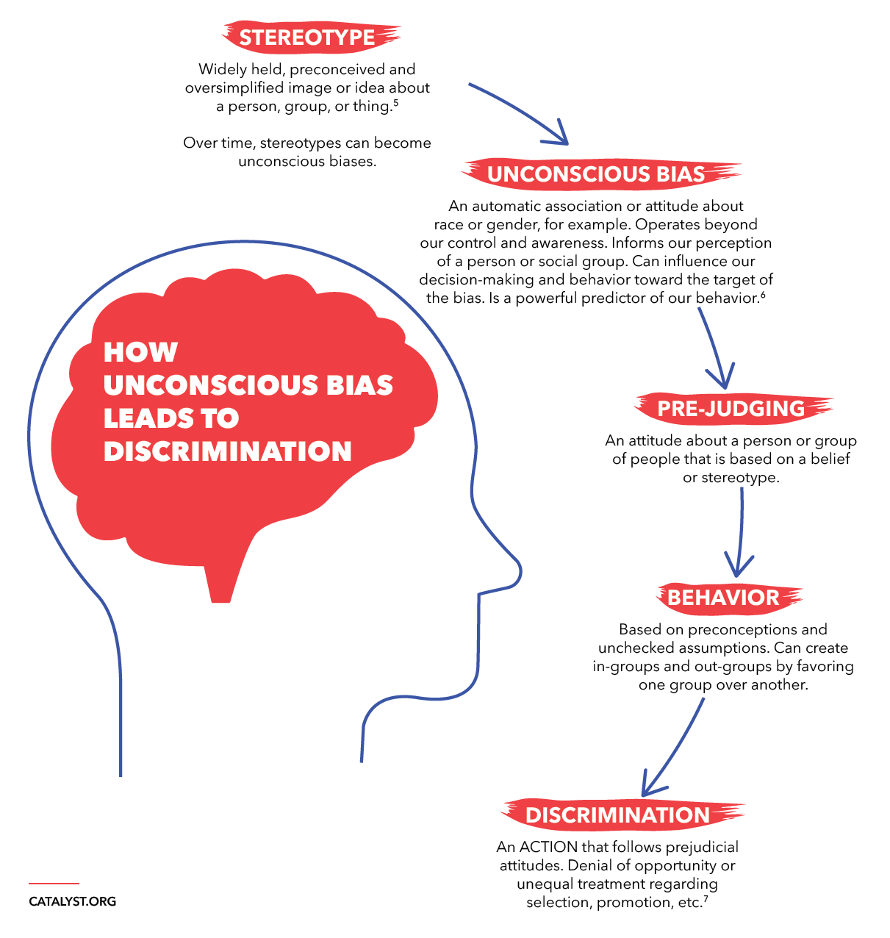
Notes:
Over time, our stereotypes can become automatic associations—or what we call unconscious biases. They are formed by the culture around us, history, the media, movies, TV, our religions, and our own communities. Their formation starts early (as early as five years old) and happens in much in the same way as you develop habits. If you put your mobile phone and keys on the bedside table every night, that behavior will become automatic. If your culture associates men with being better at math or the media shows women as better at nurturing, over a lifetime that association becomes automatic as well. (Annie Murphy, "Where Bias Begins: The Truth About Stereotypes," Psychology Today)

Slide 9
How can we overcome unconscious bias?
Become conscious of your personal bias
Who are you?
Who is in your life?
Key: Self-Awareness
Check your bias in everyday life!
Notice when it happens, how it happens, and how others react
Address these behaviors so they stop repeating
Build relationships with others
Meet with new people, have new experiences, challenge yourself
Nurture these relationships and let it flow organically
Notes:
Unconscious, or implicit bias, is not intentional or deliberate and because of that we often think that we are not biased. Having a bias does not necessarily mean you are racist, sexist, or a misogynist. What it does mean is that you are human. We all have bias and in order to accept diversity and be intentionally inclusive we have to audit ourselves and our lives to ensure these bias do not lead to discrimination, exclusion, microaggressions, or any other exclusive behavior.

Slide 10
What else to look for?
Language used
Is it positive or negative?
Full house: “that pig,” “that human.”
Hispanic or Latino?
Ask!

Slide 11
Source: https://popeconsulting.com/services/unconscious-bias-experiential-training/

Slide 12
Diversity, Inclusion, and Scouting
Current families
New families
Recruitment
Welcome
Community
How is my unit perceived?
Notes:
Introspection is key. Take a self-inventory. Look at your self, your friends, your neighbors…what surrounds you is a reflection of how others see and perceive you. This is true for Scouting as well. What does your unit look like? Where do you meet? These things set the standard for how others, including prospective new Scouts and families, see your unit.

Slide 13
Beware of Tokenism
Definition: “…the fact of doing something only to show that you are following rules or doing what is expected or seen to be fair, and not because you really believe it is the right thing to do,” (Cambridge Dictionary)
“Symbolic Effort”
Notes:
Tokenism is often confused for inclusivity but, truly challenges all progression into building equity and inclusion. Focus your true intent. If you are only being inclusive because you think that is what you are supposed to do or you want others to think you are, you are not. In fact, this hinders true efforts and can have a negative effect for others looking to join your unit, workplace or any space involved.

Slide 14
Some final thoughts…
Diversity is simply a representation of many different types of people (gender, race, ability, religion, etc.)
Diversity often focuses on the differences
Inclusion is the deliberate act of welcoming diversity and creating an environment where all different kinds of people can thrive and succeed.
Inclusion is the act of making it work
Diversity is what you have. Inclusion is what you do.
Notes:
Diversity fuels creativity

