Slide 1
LAKE ERIE COUNCIL
2023
COUNCIL KICKOFF

Slide 2
WHY POPCORN & SYRUP?
Fund Scouting Adventures
Examples
Campouts
Blue & Gold Celebration
Pinewood Derby
High Adventures
Equipment needs
Advancement
Annual Unit Dues
Scouts Learn
The value of hard work
How to earn their own way
Public speaking
Salesmanship and people skills
Setting and achieving goals
Money management
Scouts Earn Rewards
Council Rewards
Amazon e-gift cards
Millions of rewards to choose from

Slide 3
A SUCCESSFUL SALE

Slide 4
A SUCCESSFUL SALE
Unit Leader Preparation
Attend Webinars & Training Tab
Plan your program year & key adventures
Set budget and goals via the Unit Leader Planner
If participating in Trail’s End Storefront program, reserve prime hours at prime locations
Secure your own additional storefront hours if needed
Obtain supplies:
Square Readers
Storefront supplies
Unit incentives
Review the Unit Leader Portal training tab
Prepare for your Unit Kickoff
Prepare your Scouts & Families
New Scout? Download the app
Text APP to 62771 to download/register
Setup accounts in the app (One Account per Scout)
Encourage Scouts to review the training tab
Motivate with incentives and how you will use the funds
Communicate key dates and progress

Slide 5
BUDGET & GOAL
Plan your adventures for the year
Determine Unit expenses
Dues
Advancements
Supplies
Etc.
Utilize the Unit Leader Planner tool (storefront hours, budgeting, goal setting)
Set Unit and individual Scout sales goals
Decide on Unit incentives for Scouts
Obtain Kernel Guide for planning

Slide 6
UNIT KICKOFF
Make it fun
Create excitement with food, games, and prizes
Set Stretch Goals
Review your program calendar and Unit sales goals
Assist Scouts to set their individual goals
Get started with the Trail’s End App
Scouts who sold previously use the same account
New Scouts set up an account
Each Scout requires their own account
Talk about prizes
Trail’s End Rewards – Amazon Gift Cards
Council & Unit Incentives
Training
Role play to train kids how to sell
Direct Scouts/families to the training resources in the App
Review key dates / Timeline

Slide 7
CREATE AN ENGAGING & ENERGETIC PITCH FOR THE SALE!
GET READY TO SELL
Sell More Perfect Your Sales Pitch
Big smile, make eye contact, introduce yourself, and which pack you are a part of
“Hello, I’m [Your First Name] from [Pack#]”
Let people know your goals
“I’m earning my way to [adventure or summer camp”]
Close your sale
“Can I count on your support today?”
Thank your customer and end your sale
“Thank you, we prefer credit / debit payment”
Look Sharp, Be Prepared
Always wear your Class A field uniform
Always speak clearly and say, “Thank you!”
Download the app and login in advance
Grow your sales by asking every customer
Know your products
Be ready to answer “What is your favorite flavor and why?”
Ask the customer for their support of your Scouting activities.
Tell your customer what being a Scout means to you
TIP: Visit the app training section: How to guides, tips, and resources
Notes:
How would YOU coach ME if I were a Scout? What advice would you give me?
“Give me your #1 suggestion to a successful sale!”

Slide 8
WAYS TO SELL

Slide 9
WAYS TO SELL
ONLINE DIRECT
STOREFRONT SALES
WAGON SALES
Ship direct to your customers
Record in the app
Share your page via email, text, social media or QR code
No handling of products or cash
$65 Average Order
Products & prices may vary
Shipping/Tax may apply
Available year-round
Leverage high foot traffic retailers
Reserved by Unit Leaders
Sign up to sell in person at a store
$162 per hour National average
One parent and one Scout cover more hours
Set your storefront split method in the Leader Portal before storefront sales begin
Deliver product to your family, friends and neighbors' homes
Ask parents to ask their co-workers
Mark sales delivered or undelivered
Delivered: Check out popcorn in advance, and deliver products
Undelivered: Take order and deliver products later
Always have an adult with you

Slide 10
TRAIL’S END 2023
TRADITIONAL PRODUCTS

Slide 11
S’MORES ORDERING INFORMATION
S'mores will ship at a maximum of 10% (retail) of your orders to stay in line with market research, prevent excess inventory, and manage production constraints.
For every $3,000 ordered, Units can only order 1 case (12 bags) of S’mores. This applies to S’mores only.

Slide 12
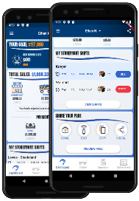
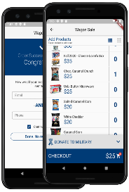
ONLINE SALES
Via the Trail’s End App
No Cash or Product Handling
$65 Average Order Value
SHARE YOUR PAGE
Share your fundraising page via email, text, or social media.
Customers click your link to place online orders.
Products ship directly to your customer’s home.
DIRECT ORDERS
Pick your products.
Credit or debit payments only
Products ship directly to your customer’s home.
TIP: Additionally share your page during online holidays: Amazon Prime Day in July & October*, Black Friday & Cyber Monday
*Subject to Change

Slide 13
ONLINE ASSORTMENT
www.trails-end.com
$20
$25
$25
NEW
$27
$34
$50
IMPROVED FLAVOR
NEW
NEW
$42
$47
$72
$62
$54
$45
NEW
NEW
Road Trip Variety Pack
Movie Night Bundle
Picnic Bundle
Let’s Go Hiking Bundle
Ultimate Snack Pack
Game Night Bundle
$27
$35
$30
$55
LIMITED TIME OFFERINGS:
Snowflake Pretzels 7 oz $35
Peppermint Bark 9 oz $40
Dark Choc Sea Salt Caramels 10.5 oz $35
Chocolate Lovers Bundle $95
Chocolate Trio Bundle $110
*Products & Pricing are subject to change

Slide 14
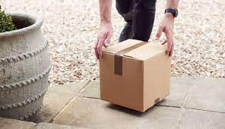
ONLINE SALES
www.trails-end.com
Shipping Information
Effective 7/5/2023
$10.99 Paid Freight (vs. $13.99)
$65+ Free Shipping (vs. $70)
+$3.00 Handling
Microwave, Popping, Sea Salt Snack Pack (new)

Slide 15
TRAIL’S END TECHNOLOGY FOR LEADERS
MAKE YOUR SALE EASY!
Trail’s End App for Scouts
Text APP to 62771 to download / register
Record sales (accept credit cards)
Storefront sign up
Track goals’ progress
Record deliveries
Share online sale page
Claim rewards
Unit Leader Portal
www.trails-end.com/leader
Manage all things sale-related
Mobile-friendly portal via your phone’s browser
When Scouts use the app, Leaders can:
Track progress toward goals
Inventory monitoring
Oversee storefront sign-ups
Storefront setups
Split sales
Manage accounting and more!
TIP: ALL Credit Card Fees Paid by Trail’s End when sales recorded via the APP

Slide 16
CREDIT CARDS
Many consumers prefer credit or debit card transactions
“Advise your customers we prefer credit or debit payments”
Trail’s End covers credit card fees for transactions recorded via the APP*
Earn 1.25 Reward points for every $1 sold app credit card
No cash handling for Scouts or Unit Leaders
Square readers are compatible with the Trail’s End App
Square Bluetooth readers also accept Apple Pay and Google Pay
ALL Scouts can enter credit cards manually
Parents pay Wagon Sales cash due by clicking “Pay Now” on the Wagon Sale screen**
*TIP: Recording sales via the Trail’s End app is required for credit card fees to be covered (Square app not required)
**NOTE: Using Pay Now does not qualify as a credit card sale towards Trail’s End rewards points

Slide 17
TRAIL’S END
MANAGED STOREFRONTS
Prime hours and prime locations booked by Trail’s End
Reservations Begin TODAY (July 8)
Up to 5 picks each day for one week, then unlimited picks after.
Benefits
Saves Unit Leaders time
Provides more opportunities for all Scouts to earn their way
Improves relationships with store managers
Notes:
List HANDOUT

Slide 18
UNIT BOOKED STOREFRONTS
Best practices when booking your own storefronts:
Determine high foot traffic days, times, and locations (Google Analytics)
Book one to two months in advance
Visit the store in your Uniform with one or more Scouts
Shop the store, then request to speak with the manager
If permission is granted, ask for and notate expectations and follow the rules
Always say ‘Thank you!”

Slide 19
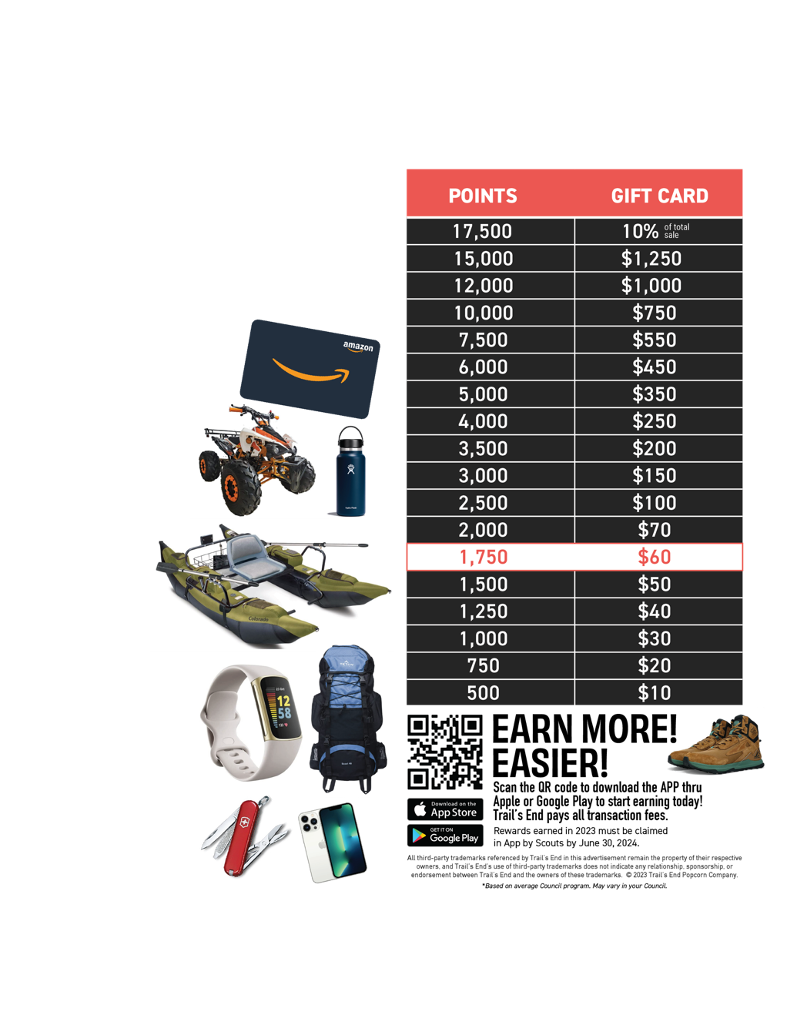
REWARDS
Record all sales via the App to qualify
Scouts earn points
1.25 points for every $1 sold app credit card and online
1 point for every $1 sold app cash
Receive an Amazon e-gift card
Scouts choose prize(s) from Amazon.com
Did You Know?!?
1,750 points ($1,500 in sales) provide funds for most Scouts’ Year of Scouting, including registration fees, handbook, uniform, Pack dues, camp, Scout Life magazine, and much more.
Plus, Scouts earn a $60 Amazon e-Gift card!*

Slide 20
SCOUT BONUSES
(Insert your Council information on Scout bonuses)
SPIN TO WIN VIDEO
Notes:
Open Discussion on Unit-sponsored Incentives
Consult the GSS
Feedback Parking Lot: Spin to Win Prizes

Slide 21
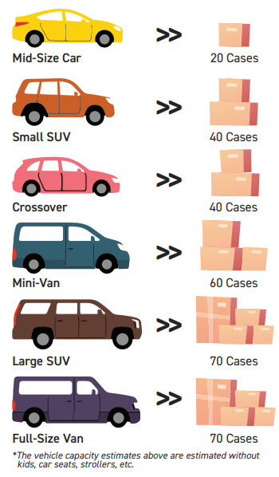
ORDERS & DISTRIBUTION
July 8, 2023 – July 27, 2023 – Popcorn Trainings
August 28, 2023 – Show and Sell Orders Due on trails-end.com
September 8-9, 2023 – Show and Sell Distribution
September 22-24, 2023 – Blitz Weekend
October 13, 2023 – Amnesty Return Deadline for all full cases (excluding Chocolate Pretzel)
October 20-22, 2023 – 2nd Blitz Weekend
November 3, 2023 - Take Orders Due on trails-end.com
November 10, 2023 - Payments Due
November 17-18, 2023 - Take Order Distribution

Slide 22
KERNEL CHECKLIST
July/August
September
October
Determine your budget & set your goals
Place an initial order
Attend a Trail’s End Webinar
Join the Trail’s End Facebook Group
Hold your Unit Kickoff
It’s Cub Scout recruiting season! Register their account to sell popcorn!
Check Council calendar for replenishment opportunities
Communicate with your Unit; progress toward goals, storefront opportunities, key dates, etc.
Motivate your Scouts & Families, i.e., incentives and reminders of what funds do for your unit & Scouts.
Collect cash due from Scouts
Place your final order
Distribute popcorn and ensure deliveries are made
Pay your Council invoice or request your payout
Submit rewards for your Scouts
Celebrate your Success!

Slide 23
2023 TRAINING & LIVE SUPPORT

Slide 24
UNIT LEADER WEBINARS
Attend Live Moderated Webinars
Register at www.trails-end.com/webinars
New & Existing Unit Kernels are encouraged to attend
Sessions run from July 6 – Sept 9
Training Tab in Unit Leader Portal
Review recorded webinar videos, separated by topic

Slide 25
COMMIT YOUR UNIT!
If you have not registered your unit for the Popcorn Sale, please do so today!
www.trails-end.com/unit-registration
Agenda
Products

Slide 26
HAVE QUESTIONS?
GET ANSWERS
LEC Popcorn Hotline
Heather McMillan 216-458-8911
heather.mcmillan@scouting.org
Popcorn Advisors
Jim Vanderpool
(216) 458-8920 Jim.Vanderpool@scouting.org
Jason Setser
(216) 458-8923 Jason.Setser@scouting.org
Mike Evano
(216) 331-4616 Mike.Evano@scouting.org
Trail’s End Support
Join Unit Leader Popcorn Community Group
Text FACEBOOK to 62771
Join Scout Parent Facebook Group
Text PARENTFB to 62771
Visit our FAQ’s
https://support.trails-end.com

Slide 27
QUESTIONS?

Slide 28
THANK YOU!

