Slide 1
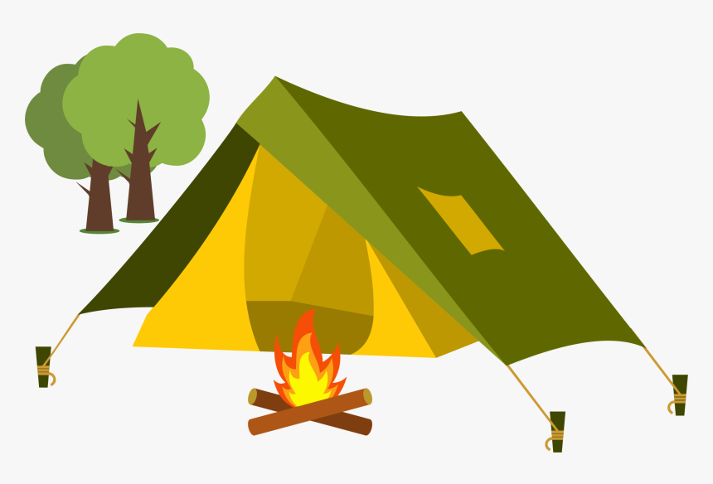
CUB SCOUT PARENT ORIENTATION GUIDE
WELCOME!

Slide 2
MY SCOUTING DEN CONTACTS
Use this to save important information about your pack and leaders.
MY PACK NUMBER: ______________________________________________________________
MY DEN LEVEL (RANK): ___________________________________________________________
[Kindergarten=Lions; 1st Grade=Tigers; 2nd Grade=Wolves; 3rd Grade=Bears; 4th Grade=Webelos; 5th Grade=Arrow of Light]
MY DEN LEADER NAME(S): _______________________________________________________
_______________________________________________________________________________
MY DEN LEADER PHONE NUMBER(S): ______________________________________________
_______________________________________________________________________________
MY DEN LEADER EMAIL(S): _______________________________________________________
_______________________________________________________________________________
MY DEN MEETS ON: ___________________________ (day) AT ______________________ (time)
MY DEN MEETS AT: ______________________________________________________ (location)
OTHER DEN PARENTS: (names, phones, emails):
_______________________________________________________________________________
_______________________________________________________________________________
_______________________________________________________________________________
_______________________________________________________________________________

Slide 3
SCOUTING FUN AND VALUES
As a parent, you want your child to grow up to be a self-reliant, dependable and caring leader. And to have memorable fun experiences. Scouting has these same goals in mind for your child.
WHAT IS SCOUTING?
Scouting is about positive youth development through programs for all youth. Cub Scouts is for boys and girls in Kindergarten through 5th Grade.
Cub Scouts helps to support your family by providing ready-made adventures and activities for you and your child to enjoy together.
Scouting offers an emphasis on friendship and building self-esteem. Your child will be with a group of peers and parent leaders that teach values of good citizenship, character and leadership in a safe environment.
Scouting teaches family values and works to strengthen your relationship with your child.

Slide 4
SCOUTING SAFELY
BSA places the greatest importance on creating the most secure environment possible for our Scouts.
BSA’S COMMITMENT TO SAFETY:
True youth protection can be achieved only through the focused commitment of everyone in Scouting.
Get Youth Protection Trained today! This is required for all registered volunteers to help keep kids safe.
The Guide to Safe Scouting is the reference guide for Youth Protection and Adult Leadership. You can download your copy at Scouting.org/SafeScouting.
Be aware. Know the BSA’s policies on Safe Scouting and stay up to date on your training.
BARRIERS TO ABUSE:
BSA has adopted several robust policies for the safety and well-being of our members. These policies primarily protect youth members; however, they also serve to protect adult leaders. Parents using these safeguards outside Scouting further increase the safety of all children.

Slide 5
HOW WE OPERATE
YOUR DEN:
A den is a small group of youth in the same grade, who meet with adult leaders to do Scouting “Adventures”, play games, learn skills, perform skits and songs, and take field trips.
Dens meet weekly during the school year and once or twice a month during the summer months.
A den is led by volunteer Den Leaders. Most leaders are parents of Cub Scouts, and every parent is a leader to their Scout!
YOUR PACK:
You and your Scout and the den are members of a pack.
The pack (all grade levels) meet monthly.
Special activities and Community Service opportunities are available to Scouts monthly.
Pack activities are led by a volunteer Cubmaster or other parent leaders.
YOUR CHARTERED ORGANIZATION:
Your pack is sponsored by a Chartered Organization.
Chartered Organizations have permission to operate a Scouting program.
Our Chartered Organization is the First Congregational United Church of Christ or ‘The Big White Church’ in Berlin Heights.

Slide 6
PACK LEADERSHIP
Your Scout’s pack is led by parent volunteers who provide leadership to a variety of key positions that ensure every youth and family has a quality Scouting experience.
Chartered Organization Representative – the direct contact between the Pack and the Chartered Organization.
Committee Chairperson - appoints and supervises the pack committee and pack leaders.
Pack Committee –
Treasurer – keeps records of pack funds and reports to the committee.
Activities Coordinator – plans pack events with input from Cubmaster. Recruits leaders/parents to help with programs.
New Member Coordinator(s) – “welcome” team to help welcome families and guide them on how to get the most out of Scouting.
Parent Helpers/Committee Members – involved in program jobs of short duration.
Cubmaster – plans and carries out the pack program under the guidance of the committee and with the help of leaders/parents.
Den Leader/Assistants – leads the den at den adventures and pack activities. Guides parents on how to lead/assist their Scouts.

Slide 7
NEW SCOUT BASIC NEEDS
YEARLY FEES:
Annual Registration Fee is $XX (price subject to change).
Optional Scout Life magazine subscription $15 yearly.
There may be additional fees for activities throughout the year.
CUB SCOUT HANDBOOK:
Each grade level has a specific handbook they use.
Handbooks are about $24 and are used for the year.
Handbooks have all the required and elective adventures for each rank.
Handbooks can be purchased at the Firelands Scout Store (Wakeman) or on ScoutShop.org.
BSA SCOUTBOOK:
Scoutbook is an advancement tracking tool. It also has messaging, forums, service, hiking, camping tracking and calendaring features.
There is an app; however, we recommend using the web version even on your mobile device.
Access Scoutbook at Scoutbook.scouting.org.

Slide 8
NEW SCOUT BASIC NEEDS (con’t)
GROUPME:
Free messaging app that keeps the pack and dens connected.
You will receive an invite to join the messaging app; make sure to reply with a simple “hello” to join the group(s).
PACK CALENDAR:
A pack calendar is developed every June for the next Scouting year.
The calendar will be provided to all Scouts and parents via email and can be requested from any den or other Scout leader.
CUB SCOUT UNIFORM – “CLASS A”:
Each Scout will ideally have a full uniform that is to be worn at weekly den meetings and other monthly activities (unless otherwise stated).
Uniforms can be purchased at the Firelands Scout Store (Wakeman) or online at ScoutShop.org.
CUB SCOUT UNIFORM – “CLASS B”:
Scouts may also wish to have a less formal option for some of our fun/dirty activities.
Order forms can be requested from any den or other Scout leader.

Slide 9
THE ADVANCEMENT PLAN
All Scouts should have their own Cub Scout Handbook or access to Scoutbook and work on their age-appropriate “Rank Badge”.
LION (Kindergarten) – Five required adventures
including outings. Additional elective adventures. Recognized by adventure loops and rank badge.
BOBCAT – No matter what age or grade a child joins Cub Scouts, they must earn the Bobcat Badge. (Lions earn
this after the completion of the Lion program.)
TIGER (1st Grade) – Six required adventures plus one elective. Additional electives if desired. Recognized by adventure loops and rank badge.
WOLF (2nd Grade) – Six required adventures plus one elective. Additional electives if desired. Recognized by adventure loops and rank badge.

Slide 10
THE ADVANCEMENT PLAN (con’t)
All Scouts should have their own Cub Scout Handbook or access to Scoutbook and work on their age-appropriate “Rank Badge”.
BEAR (3rd Grade) – Six required adventures plus one elective. Additional electives if desired. Recognized by adventure loops and rank badge.
WEBELOS (4th Grade) – Five required adventures plus one elective. Additional electives if desired. Recognized by adventure pins and rank badge.
ARROW OF LIGHT (5th grade) – Four required adventures plus one elective. Additional electives if desired. Recognized by adventure pins and rank badge.

Slide 11
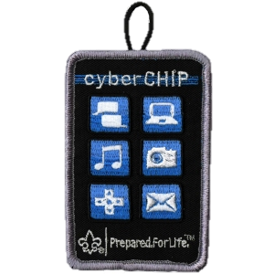
SPECIAL AWARDS & RECOGNITION
CYBER CHIP – To help families and volunteers keep youth safe while online, the Cub Scout program uses the Cyber Chip award to instruct and increase awareness. For 1st through 5th grade.
CUB SCOUT RECRUITER – This award recognizes a Scout who recruits a friend into Scouting. Any Scout can recruit a friend and earn this badge.
CUB SCOUT OUTDOOR ACTIVITY – This award recognizes a Scout for taking part in outdoor recreation and conservation projects.
RELIGIOUS EMBLEMS – These awards encourage members to grow stronger in their faith.

Slide 12
SPECIAL AWARDS & RECOGNITION (con’t)
CUB SCOUT WORLD CONSERVATION – To encourage Scouts to “think globally” and “act locally” to preserve and improve our environment.
STEM/NOVA - The STEM/NOVA Award incorporates learning with cool activities and exposure to science, technology, engineering, and mathematics for Cub Scouts.
NATIONAL SUMMER TIME PACK AWARD – The pack can qualify for the National Summertime Pack Award certificate and streamer by planning and conducting three pack activities during the summer—one each in June, July, and August.
SHOOTING SPORTS – Tigers to Webelos Scouts can earn awards for learning the safety rules and participating in three different disciplines of shooting sports: archery, BB gun, and slingshot.

Slide 13
CUB SCOUT ACTIVITIES
CAMPING - KEEP THE OUTING IN SCOUTING:
Lake Erie Council Camping Events
Cub Scout Resident Camps
Pack Campouts
Several combined campouts with BSA Troop 236
OTHER ANNUAL ACTIVITIES:
Pinewood Derby Race
Fishing Derby
Aquatics Day
Trash the Trash Day
Lake Erie Crushers game and overnighter
Cub Haunted
Christmas Party
Sports Day
Scout Sunday
And many, many more!

Slide 14
FUNDRAISING
Scouting is one of the most affordable programs for families to take part in. With all the new skills learned, friends made, and fun, it is definitely the best return on your investment.
The Scout Law teaches Scouts to be thrifty and earn your own way!
POPCORN SALES:
The annual popcorn fundraiser is a council-supported fundraiser.
This fundraiser helps pay for camp experiences, registration fees, and much more.
Scouts will have opportunities to set up at store-fronts to earn sales.
Scouts are also able to earn sales using the Trail’s End app.
More information is sent out annually in late summer.
OTHER FUNDRAISERS:
There are several other opportunities during the year for Scouts to earn their own way.
Information will be sent out as it is available.

Slide 15
CUB SCOUT RESOURCES
PACK 236:
5 E Main Street
Berlin Heights, OH 44814
(440) 742-0626
facebook.com/cubscout236
LAKE ERIE COUNCIL:
lecbsa.org
FIRELANDS SCOUT RESERVATION AND STORE:
13782 Gore Orphanage Rd
Wakeman, OH 44889
(440) 965-7025
facebook.com/fsrbsa
SCOUTBOOK:
Scoutbook.scouting.org
Boy Scouts of America (BSA):
Scouting.org
BSA ONLINE STORE:
ScoutShop.org
SCOUTING MAGAZINE:
ScoutingMagazine.org

Slide 16
THANK YOU!

